Slide 1
Machine Learning
Unit – 5 – [Part 1]
Reinforcement Learning

Slide 2
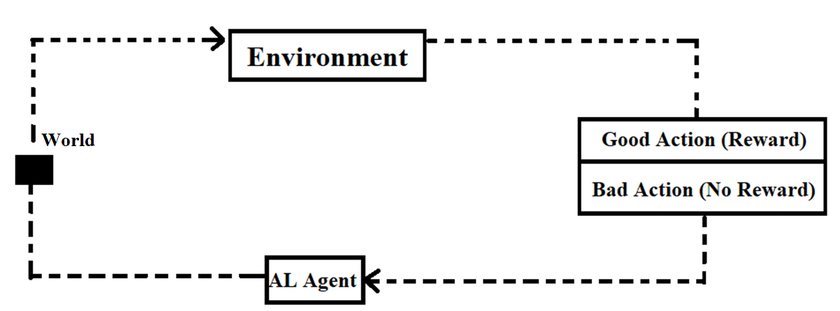
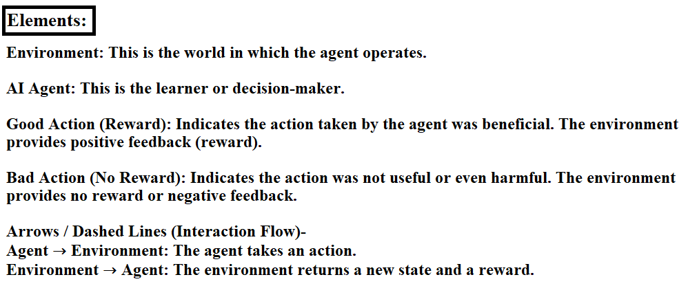
Reinforcement Learning & it’s elements:-

Slide 3
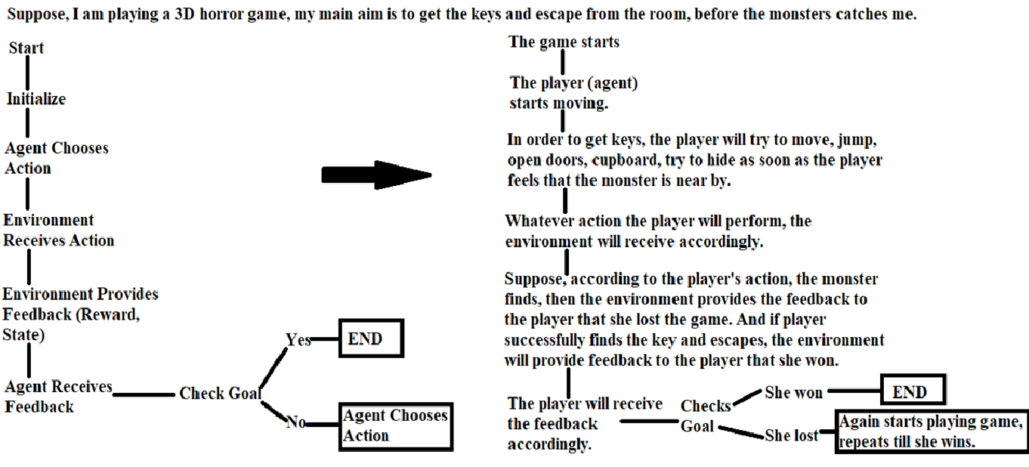
For example:-

Slide 4
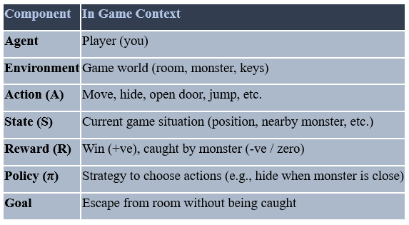
Elements:-

Slide 5
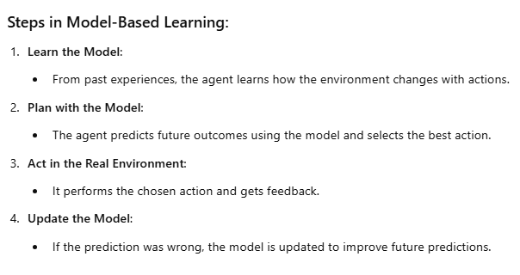
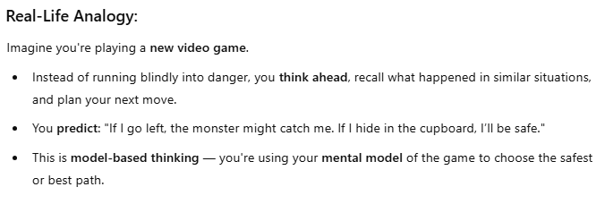
Model-based Learning

Slide 6
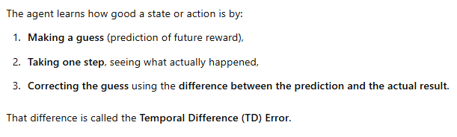
Temporal Difference (TD) Learning

Slide 7

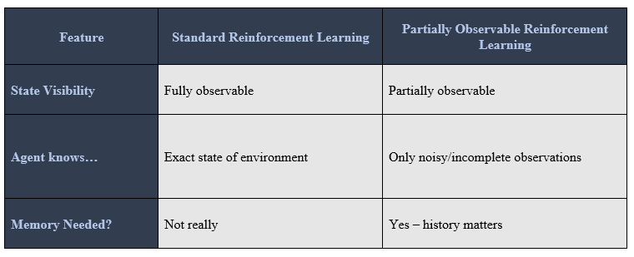
Partially Observable States

